Slide 1

using PCA to enhance DDoS attack detection in IoT
Presented By :-
2447021 - Prashant Kumar Mishra
2447050 - Mayank Shaw
2447052 - Satyam Bhardwaj
2447076 - Akash Singh
NATIONAL INSTITUTE OF TECHNOLOGY PATNA MCA(AI & Iot) mathematical Foundations Of Computer Applications

Slide 2
Table of contents
Overview of DDoS Attacks in iot 1
What is IoT
What is a DDoS attack?
Importance of DDoS Attack Detection 2
Why is DDoS detection crucial in IoT?
Consequences of undetected DDoS attacks on IoT devices
Challenges in Detecting DDoS Attacks in IoT 3
What is Principal Component Analysis? 4
How PCA Helps in DDoS Detection
Approach and dataset 5
Data analysis , preprocessing and feature selection 6
Machine learning classifiers 7
Result and comparison 8
accuracy, precision, recall, and F1 score in detecting DDoS attacks 9
Conclusion 10
References 11

Slide 3

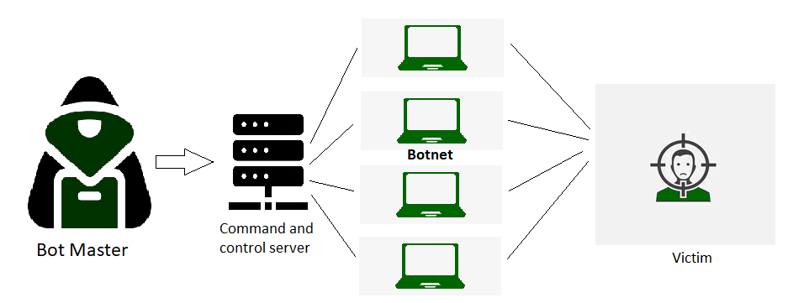
Overview of DDoS Attacks in iot
What is IoT
IoT stands for Internet of Things. It refers to the interconnectedness of physical devices, such as appliances and vehicles, that are embedded with software, sensors, and connectivity which enables these objects to connect and exchange data
What is a DDoS attack?
Distributed Denial of Service (DDoS) is a type of DOS attack where multiple systems, which are trojan infected, target a particular system which causes a DoS attack.
From a high level, a DDoS attack is like an unexpected traffic jam clogging up the highway, preventing regular traffic from arriving at its destination.

Slide 4
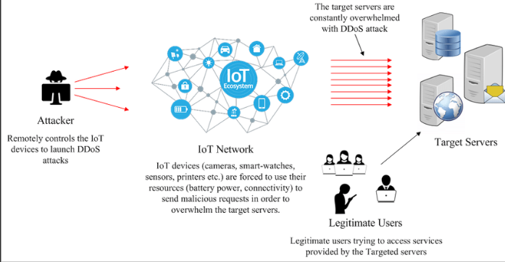
Importance of DDoS Attack Detection
Why is DDoS detection crucial in IoT?
For IoT installations to be secure, reliable, and available, it is critical to detect these assaults in IoT devices.
Consequences of undetected DDoS attacks on IoT devices
Important services, private information, and money can all be lost due to these kinds of attacks. The potential impact is magnified by the networked nature of IoT devices. Once compromised, these devices can be used to conduct large-scale attacks.

Slide 5
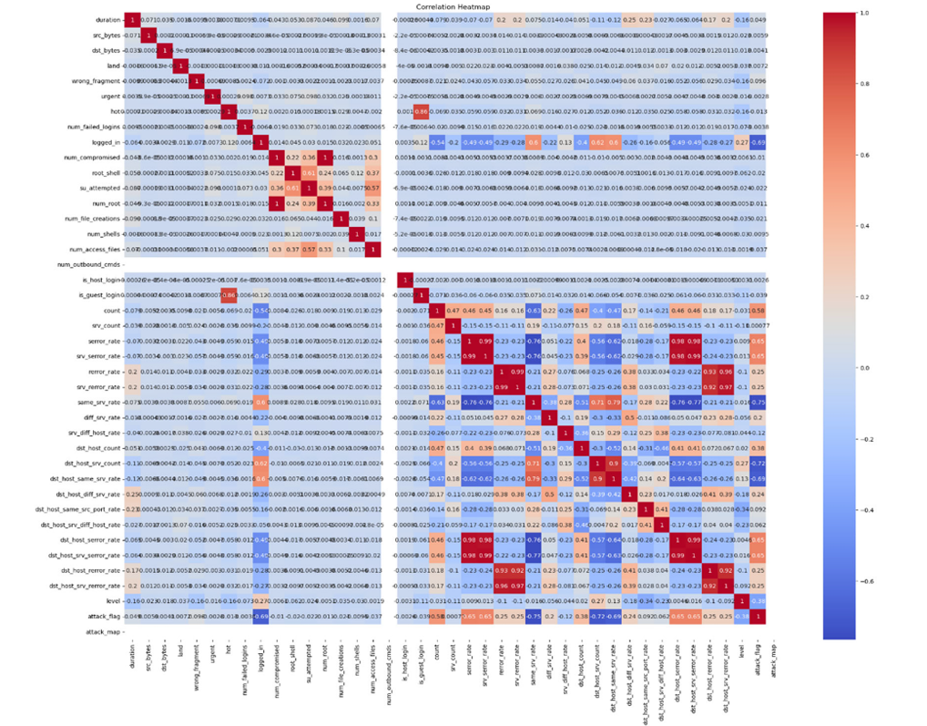
Challenges in Detecting DDoS Attacks in IoT
Large volume of data generated by IoT devices
Complexity and variety of network traffic
Traditional detection methods struggle with high-dimensional data

Slide 6
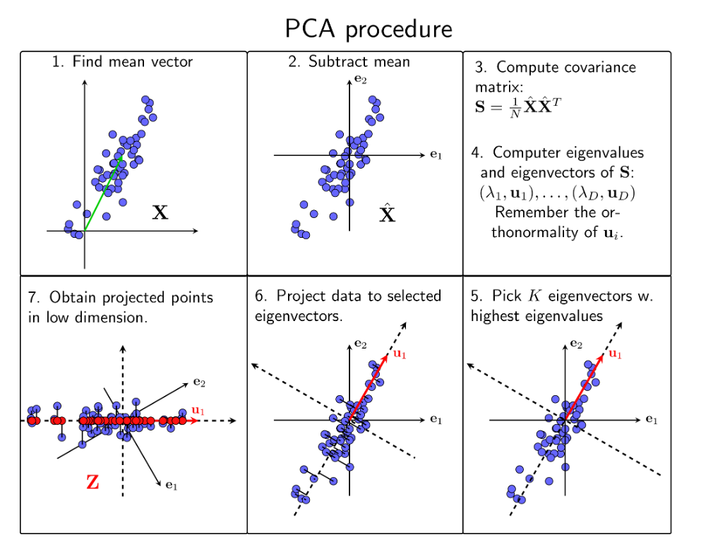
What is Principal Component Analysis?
Principal Component Analysis (PCA) is a statistical procedure that uses an orthogonal transformation that converts a set of correlated variables to a set of uncorrelated variables
How PCA Helps in DDoS Detection
Reduction of the feature space
Eliminates noise and reduces overfitting
Improves classifier efficiency and performance of ml techniques used

Slide 7
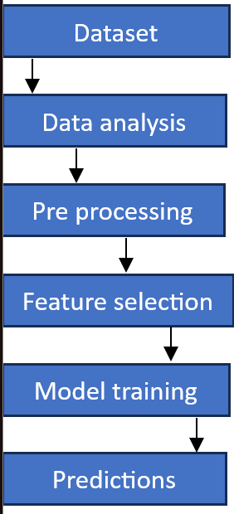
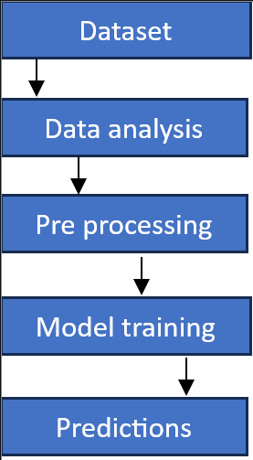
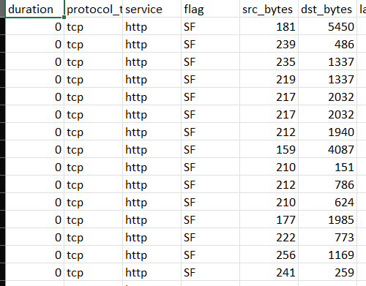
Approach without pca
Approach with pca
input dataset
the data set used is from nsl - kdd cup 1999 , This database contains a standard set of data which includes a wide variety of intrusions simulated in a network environment. The dataset contains 494021 tuples and 42 different attributes .

Slide 8

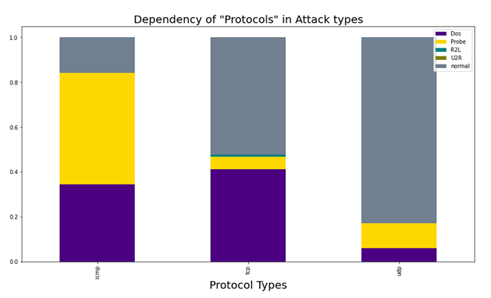
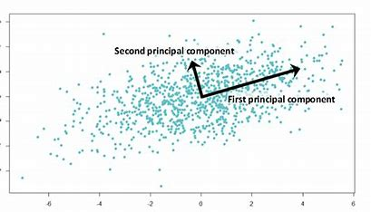
data analysis
preprocessing
Feature selection
Data analysis is used to get insights about the dataset. Here it is used to pictorially see the dependencies of Different Protocol on different types of DDoS attack , info about missing values , duplicates and categorical features .
Expanding categorical columns into binary columns, Dealing with duplicate entries , Normalization of numerical features , efficiently handling outliers .
We use principal component analysis (PCA) feature selection to find the most useful characteristics. PCA enhances the detection capabilities by lowering the number of characteristics from 42 to 20. This allows for more effective analysis while also reducing processing cost.

Slide 9
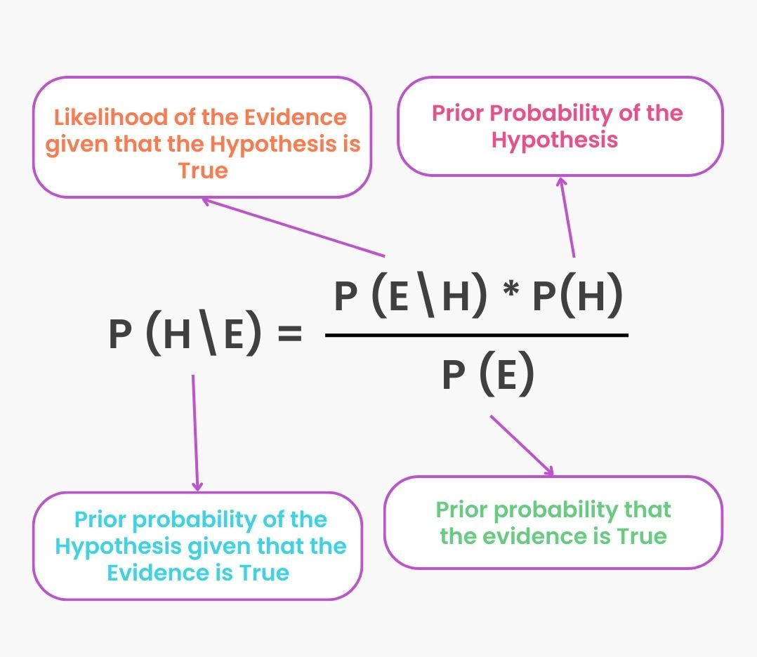
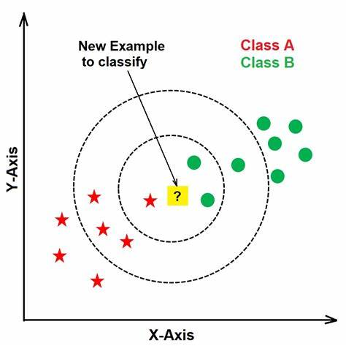
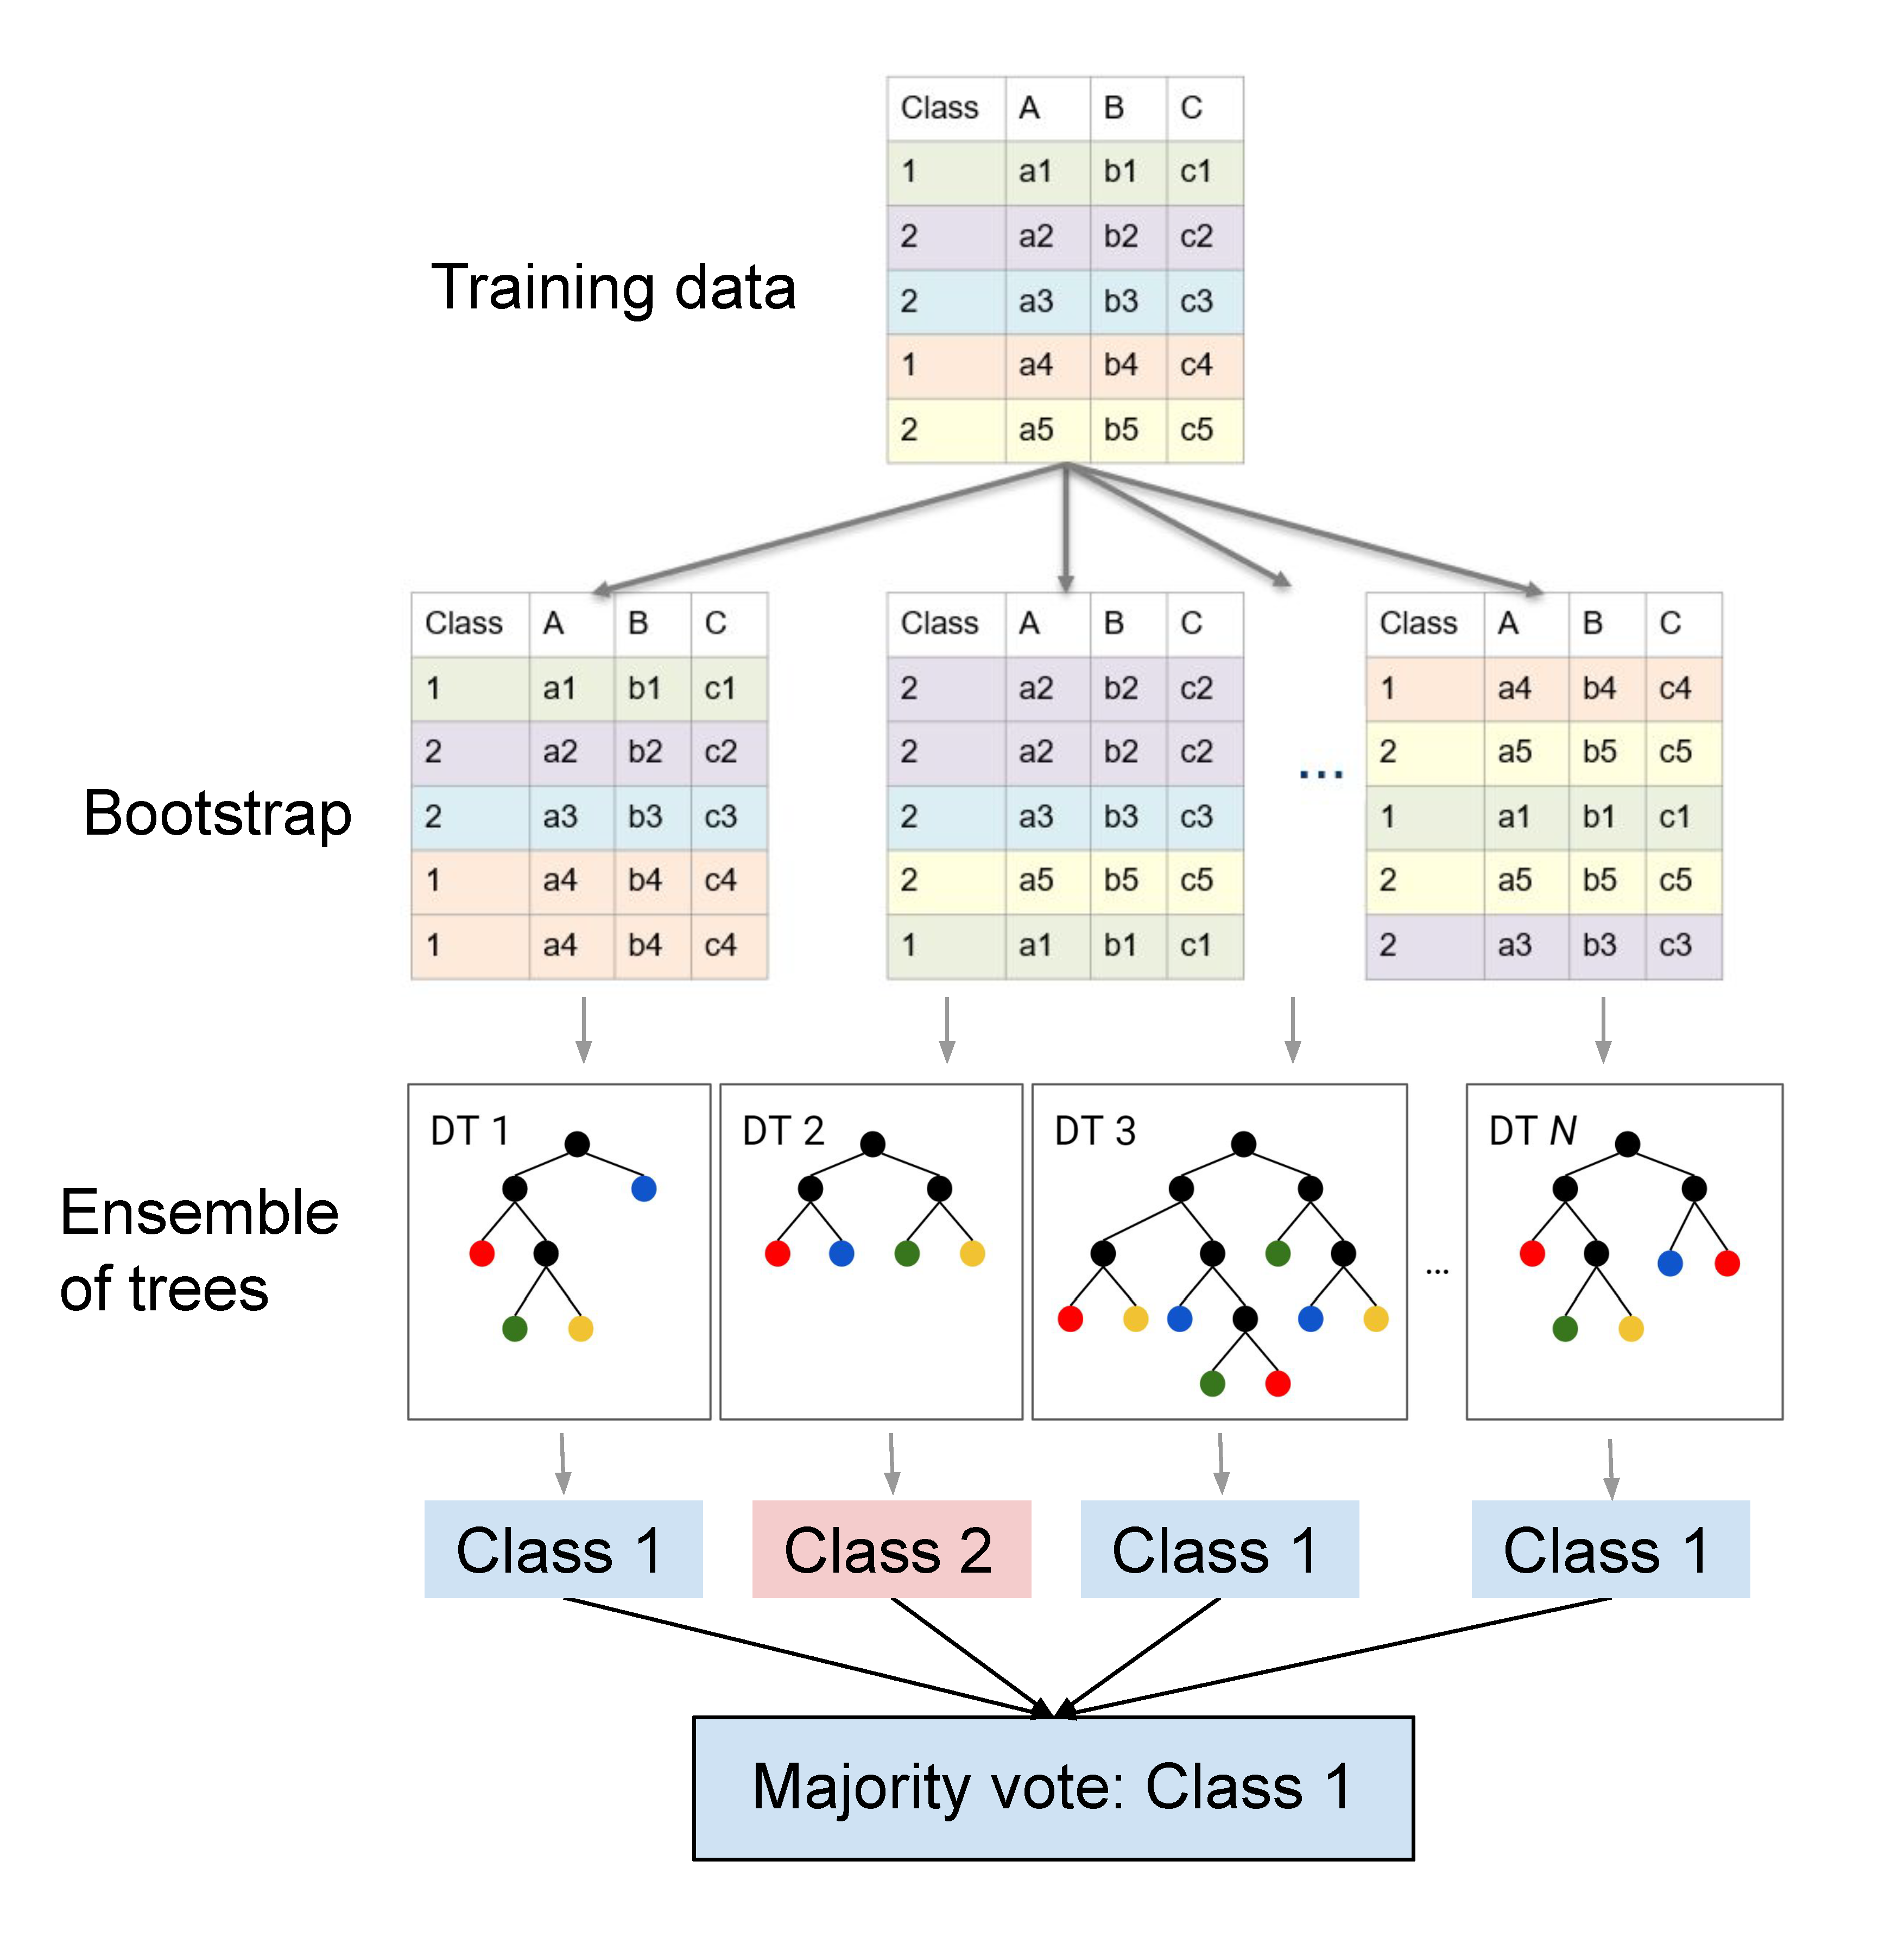
Machine learning classifiers used
Naive Bayes
Naive Bayes was used since it is good at recognizing assaults with certain traits and it assumes that features are independent.
KNN
The simplicity and ability of KNN to capture local patterns in the data led to its employment in attack detection
Random Forest
Random forest was selected because of its scalability, robustness, and capacity to handle high-dimensional data

Slide 10
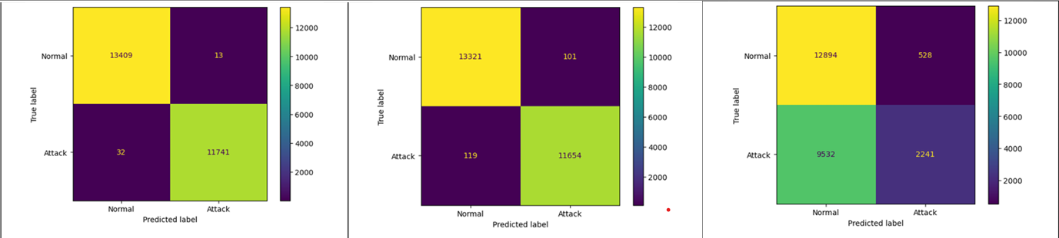
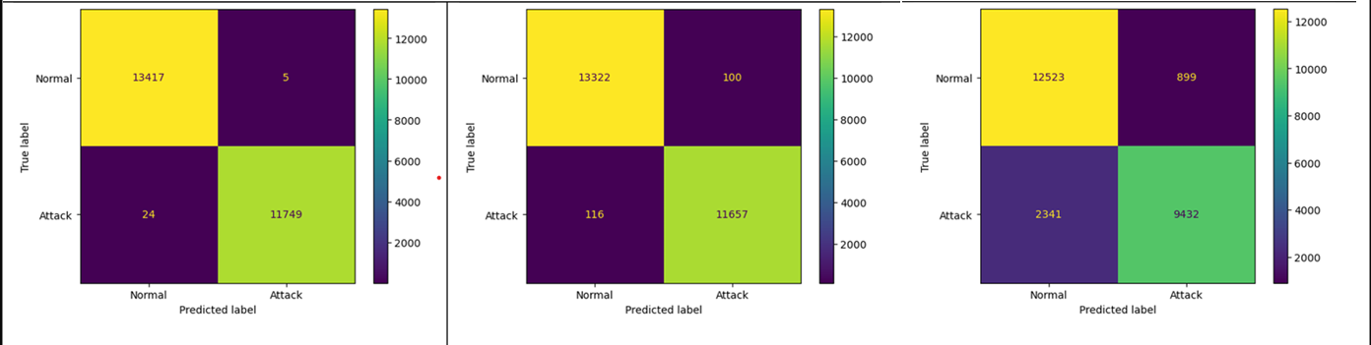
Result and comparison
In detecting a DDoS attack in IoT devices, a confusion matrix can be used to evaluate the performance of a machine learning-based detection system.
Confusion matrix without using pca
Confusion matrix with using pca
Random forest classifier
K nearest Neighbour
Naive Bayes

Slide 11
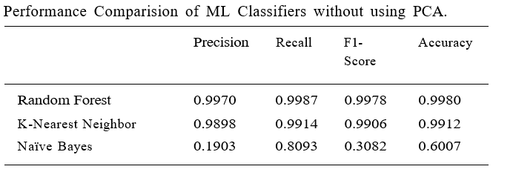
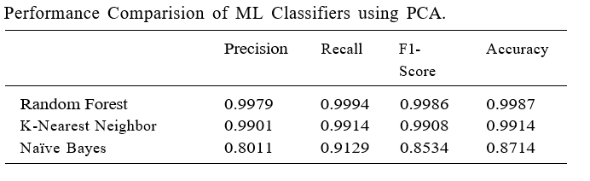
the Random Forest and K-Nearest Neighbour classifiers demonstrated high precision, recall, F1-score, accuracy, and kappa coefficient. while the Naïve Bayes classifier showed notably lower performance. On the other hand, when PCA is applied, the overall performance of the classifiers improves.
accuracy, precision, recall, and F1 score in detecting DDoS attacks.

Slide 12
Conclusion
Feature Selection:
Principal Component Analysis (PCA) was applied to the dataset to reduce dimensionality and improve classifier performance
Applying PCA improved the performance of most classifiers, leading to higher accuracy, recall, F1-score, precision
Random Forest classifier combined with PCA proved to be an effective method for detecting DDoS attacks on IoT devices.

Slide 13
REFERENCES
https://www.sciencedirect.com/science/article/pii/S1110866524000136?via%3Dihub
https://www.trndigital.com/wp-content/uploads/2024/01/MicrosoftTeams-image-1038x576.png
https://media.geeksforgeeks.org/wpcontent/uploads/20200410011058/Untitled216.png

